Slide 1
Statistical Machine Learning

Slide 2
Day 1
What Is Statistical Learning?
Why Estimate f?
How do we estimate f?
The Trade-off Between Prediction Accuracy and Model Interpret ability
What is machine learning
Supervised Learning
Unsupervised Learning
Reinforcement Learning
Basic Statistics and Linear Algebra for Machine Learning
Randomness and Probability distributions
Sample mean, variance
Vectors and matrices
Matrix operations (multiplication, dot product, Cross product, inverse, Transpose)
Multi dimensional data
Linear dependence independence

Slide 3
Day 2
Basics of Python / R
Numpy (Np array)
Pandas
Matrix multiplication using numpy
Dot product
Data in python
Matrix slicing
Histogram
Plots
Data analysis on Loan Prediction
Matrix and DataFrame in pandas
Some functions SKlearn

Slide 4
Day 2
Linear Regression (just using one variables)(In detail)
Introduction of hypothesis and Cost Function
Idea of curve fitting
Derivation and calculation of weights (Gradient descent)
Code for linear regression
Normal Equation easy trick
Lasso Regression
Ridge Regression
Classification using K Nearest Neighbours Algorithm
Idea of similarity between samples
Detailed algorithm
Code using Package
Main Challenges in Machine Learning
Testing and Validating

Slide 5
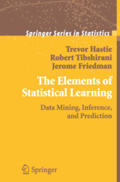
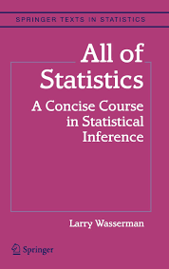
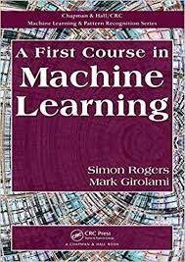
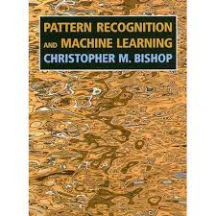
Books

Slide 6
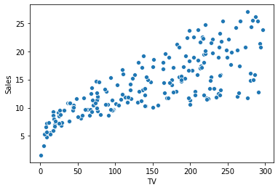
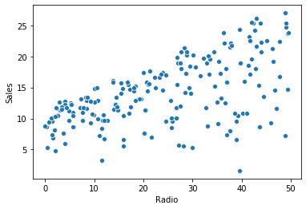
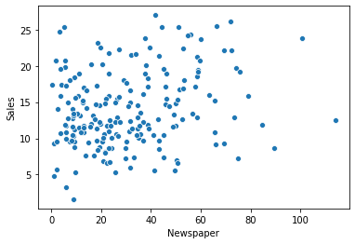
What is Statistical Learning?

Slide 7
Why to estimate f?
Y = f(x) + ε
ε Small error with mean 0
Prediction
E(Y − Ŷ )² = E[f (X) + − f ˆ (X)] ² + Var(ε)
Reducible Irreducible

Slide 8
Why to estimate f?
Inference
Which predictors(X_{i}) are associated with the response (Y)?
What is the relationship between the response and each predictor?
Advertising example
Which media contribute to sales?
Which media generate the biggest boost in sales?
How much increase in sales is associated with a given increase in TV advertising?

Slide 9
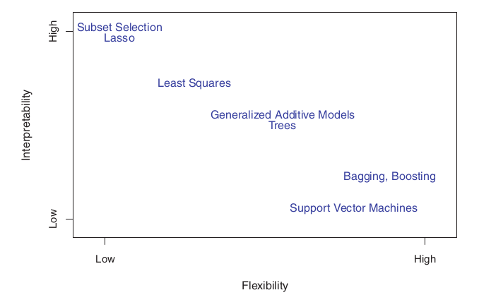
Trade-Off Between Prediction Accuracy and Model
Interpretability

Slide 10

Supervised Learning
Examples?

Slide 11
Unsupervised Learning
Examples?

Slide 12
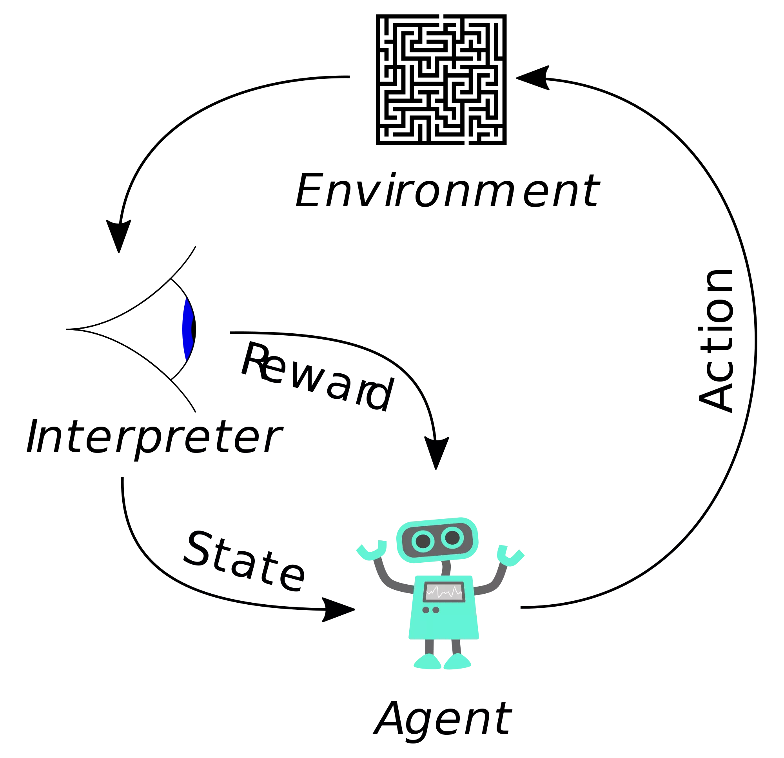
Reinforcement Learning

Slide 13
Regression Versus Classification Problems
Values could be quantitative or qualitative
Quantitative problems are considered as a regression problems
Qualitative problems are classification problems

Slide 14
Welcome to world of randomness
What Do you think about randomness?
When we add probabilities ?
When we multiply probabilities?
Independence P(AB)--->P(A)P(B)
Conditional Probability ---> P(A/B) = P(AB)/P(B)

Slide 15
Bayes Theorem
P(A/B)=P(AB) / P(B) = P(B/A).P(A) / P(B)
What is so great about bayes theorem?
Is it special form of conditional probabilities?

Slide 16
Matrices and vectors (Linear Algebra)
You can represent any data in vectors and matrices
Matrix Multiplication
Vector addition
Dot product

